Slide 1
OS Project 1
Team 21: Jhuniverse

Slide 2
Project Goal
Implement a syscall sys_ptree at syscall number 380
Sys_ptree gets a user buffer ’buf’ and its size ‘nr’
It returns number of all processes running
It writes to ‘buf’ information of processes and updates ‘nr’ to reflect number of entries copied

Slide 3
What To Do & Files Changed
define struct prinfo
include/linux/prinfo.h: define
include/linux/syscalls.h: include ‘prinfo.h’
Define Syscall of ptree
include/linux/syscalls.h: define sys_ptree
arch/arm/include/asm/unistd.h: enlarge num of syscalls from 380 to 384
arch/arm/include/uapi/asm/unistd.h: define ptree as syscall_base+380
arch/arm/kernel/calls.S: include call of sys_ptree
Make ptree Logic
kernel/ptree.c
Test Code
artik/main.c: print out process tree
artik/test.c: unit test for developers to check if kernel code works correctly

Slide 4
How ptree Is Implemented
Question: How are children & sibling tasks connected in linked list?
init_task
Children : O
Sibling: X
Proc n+1
Children : O
Sibling: O
Proc n+3
Children : X
Sibling: O
Children
Children
Children
Sibling
Sibling
Sibling
Children
Children
Sibling
Sibling

Slide 5
How ptree Is Implemented
Question: How are children & sibling tasks connected in linked list?
Task_struct has two list_heads: children, sibling
One task_struct be a member of two circular doubly linked lists
Sibling forms a main linked list, children becomes a dummy head of that linked list
Linked list with dummy head => pointing to itself means an empty list
Children
A task’s children’s next points to sibling list_head of its child task
If there is no child task, children’s next points to itself
Sibling
A task’s sibling’s next points to sibling list_head of its next sibling task
If it does not have next sibling, sibling’s next points to its parent’s children list_head
Exceptionally, init_task’s sibling’s next points to itself since init_task has no parent/sibling

Slide 6
How ptree Is Implemented
SYSCALL_DEFINE2(ptree, struct prinfo *, buf, int *, nr)
Syscall: calls do_ptree
Int do_ptree(struct prinfo *, int *)
Function: checks for errors, define and malloc kernel buf(kbuf), lock tasklist_lock, call dfs_init_task, unlock tasklist_lock, copy from kbuf to buf, knr to nr, free kbuf and return result
Errors checked: EINVAL, EFAULT, ENOMEM
Int dfs_init_task(struct prinfo *, int, int *)
Function: runs dfs starting from init_task, with no stack but if
If current task has child_task(!list_empty(&task->children)), move on to child task
If curr has no child but sibling(!list_is_last(&task->sibling, &task->real_parent->children)), move on to sibling task
If curr has no child nor sibling, move to its ancestor who have next sibling
If current task comes all the way back to init_task, it breaks

Slide 7
How ptree Is Implemented
Int dfs_init_task(struct prinfo *, int, int *) (cnt’d)
Function: runs dfs starting from init_task, with no stack but if
For each task, copy info to kbuf until possible, and add up count
Later, update knr to match copied entries of buffer and return process count
first_child_task(&struct task_struct)
Macro: exploits list_first_entry maco. Only used when child exists
next_sibling_task(&struct task_struct)
Macro: exploits list_first_entry maco. Only used when next sibling exists
Pid_t child_pid(struct task_struct *)
Function: exploits list_empty and first_child_task macro. Used for prinfo.
Pid_t sibling_pid(struct task_struct *)
Function: exploits list_is_last and next_sibling_task macro. Used for prinfo.

Slide 8
Test & Demo Video
ptree() test code
Prints copied prinfo with indentation
Implemented unit tests
Unit test for TDD: test.c
Prints FAILED tests among:
NULL value
Invalid address
Negative ‘nr’ value(-1)
Small ‘buf’
Check if ptree copied more entries than ‘nr’

Slide 9
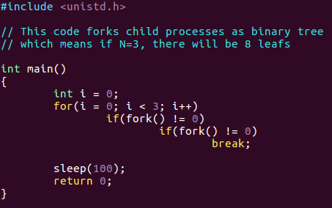
Test & Demo Video
Comparing with pstree
Make test processes with proc.c code
Executing ./proc would create full binary tree of depth 3
proc.c
proc
proc
proc
proc
proc
proc
proc
proc
proc
proc
proc
proc
proc
proc
proc

Slide 10
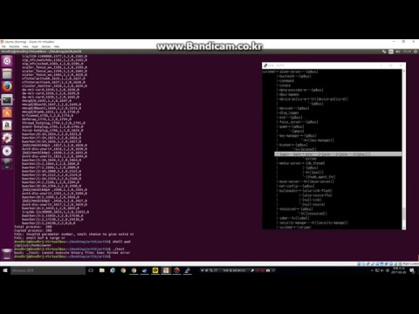
Video: Unit Test & Comparison Test

Slide 11
(Vertical View)
init_task
Children : O
Sibling: X
Children
Sibling
Proc n+1
Children : O
Sibling: O
Children
Children
Sibling
Sibling
Proc n+3
Children : X
Sibling: O
Children
Children
Sibling
Sibling

